Slide 1
Smart metering solution –Software package
Presented to:
Dominic Rabii, Business Dev Director at HKC, UAE
Author: Vijay Mohire | vijaymohire@gmail.com

Slide 2

Do you know what this diagram mean !
Once you have seen few of the slides you will know what I am trying to explain !!

Slide 3
Vision Statement
Dominic wants software solutions for three cases:
1) A new scaled up version of the Smart metering solution( software only) for 25 million homes inline with the existing one which currently caters to few thousand homes
2) A new Smart metering solution ( software only)for the complete railway network for the entire Nation in Middle East; this includes electricity consumed at various stations, signal gates and for different types of railways includes Metro
3) A new Smart metering solution (software)for the Electric companies( state and national) and related National Agencies

Slide 4
Goals and Objectives
The end state of this project will be to have an effective scalable IT solution that spans the B2B and B2C scenarios includes electricity providers and electricity consumers and authorities
Objective is to leverage on existing hardware and electrical systems in place and provide a software solution that will interface , integrate and monitor the supply and consumed electricity for effective metering
Reduction in errors , thefts and proactive governance of the supply and demand of electricity
Timely notification of issues , power outages , over consumption at all levels and all stakeholders
With better software monitoring improved finances , adherence to Government rules , quality and bylaws

Slide 5
Today’s Situation
Service providers are facing challenges in managing huge volumes of supply to 25 million homes
Currently the metering solutions are very much localized to specific supplier
Railway signaling systems do not have efficient and effective metering systems and standards
Huge gap in demand and supply leading to customer dissatisfaction
Large lead times for load management and adjustments to client accounts and other industrial consumers
Lack of transparency that leads to lack of effective governance and control

Slide 6
Solution Options
Partner with leading solution provider for an end to end solution , Smart grid and Web tier development using Cloud
Partner with leading solution provider only for Infrastructure and support; rest done in-house
Option 2; with an offshore development outsourced work for web and cloud development
Use open source products that are slightly cheaper and compromise on quality ; integrate everything in-house
Option 4 but outsource everything; only do final integration at data centre in Middle east

Slide 7
Recommendation – Option 3 and
Surely you are on the right path requesting smart metering solution
Also use concepts of Big Data Hadoop like Map-Reduce
Leverage cloud platform to handle large volumes of demand and supply side scalability and response time (SLA)
Recommended solution partners can be SAP ( software only) , Siemens , Schneider , GE , IBM , and choose an offshore developer and integrator MNC company like Wipro TCS etc
Choose other partners and domain experts and Architects who might add value to this project

Slide 8
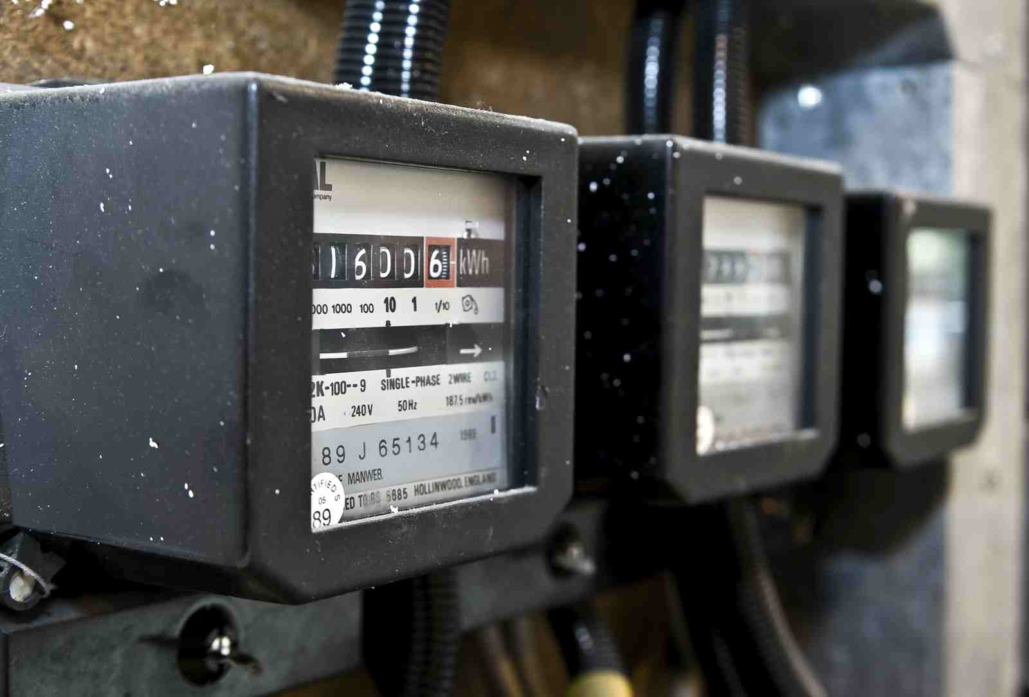
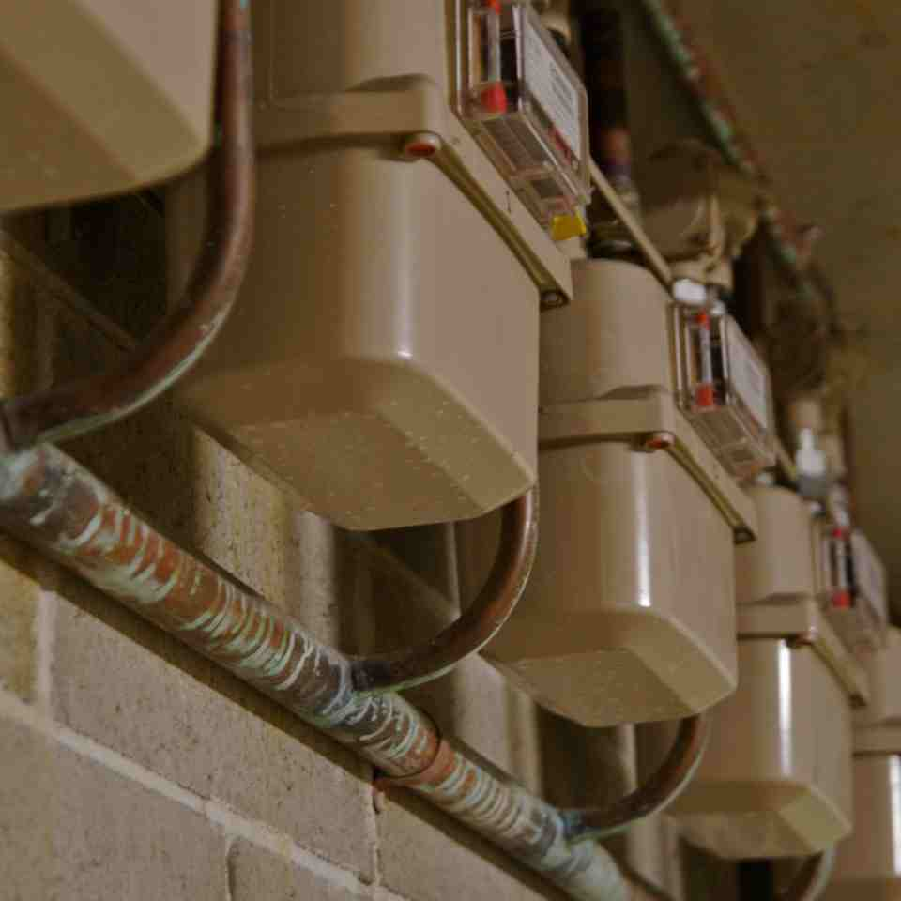
Recommendation – Option 3 details
Smart meter : We assume Smart meters are in place or will be there soon !!

Slide 9
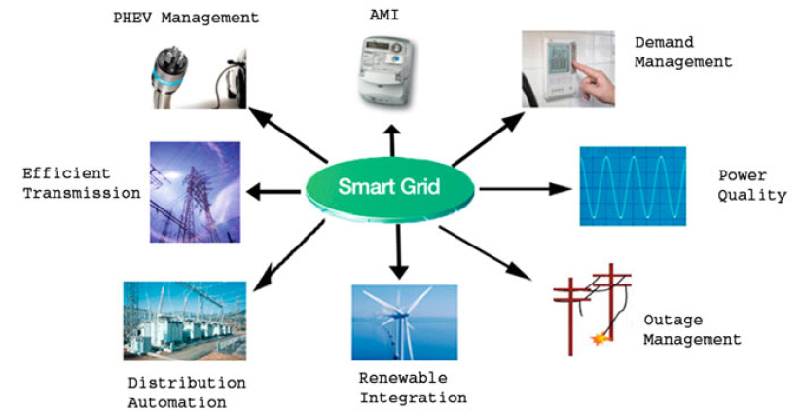
Services integrated with a smart grid system
We assume necessary grid and services are present to connect to proposed Smart meter A M I ( Advanced metering infrastructure)

Slide 10
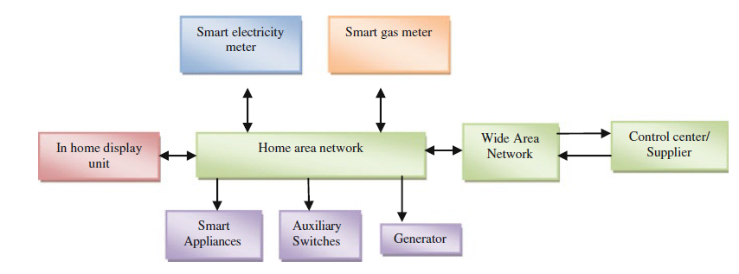
A typical smart metering system

Slide 11
Benefits of AMI
Demand Side Management: consumer is updated via SMS, email, or GPRS.
Real time information about the current energy consumption, its cost, real time pricing, estimated cost for the month, credits
Reduction in energy use from peak hours to off-peak hours
Load profiling, pre-payment, remote disconnection and reconnection
Power outage notification, tamper detection, and multi-tariffing

Slide 12
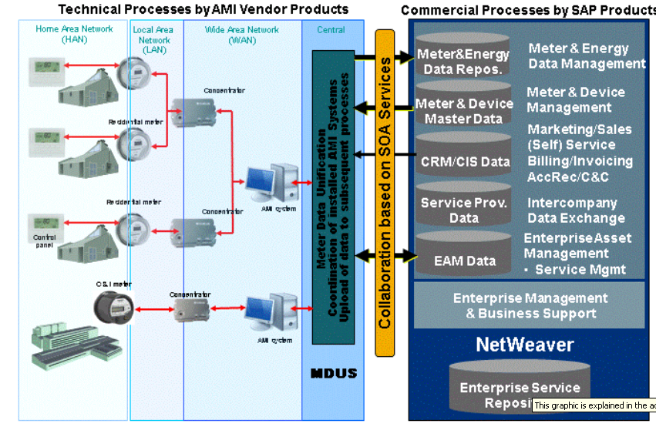
SAP - Advanced Metering Infrastructure
Device Management ; Meter Reading; Contract Billing ; Customer Service

Slide 13
Next steps
Did you feel comfortable in this strategy
You can avail more details and consider me for an opportunity in this project
Excellent academics – B.Eng, MBA, M.Tech –IT
Hands on in architeturing Smart metering solutions and Electrical products
15 years of industrial experience includes Railway signaling and SCADA system design , Integrator of Hardware and Software modules for large scale projects
Contact details: Vijay Mohire | vijaymohire@gmail.com | +91- 9741040195 | Skype: vijaymohire

Slide 14
Thank you
IT Innovators
1228 Warden Avenue
Toronto, ON, M1R2R3
Intl ph: +91-9741040195
Email: vijaymohire@gmail.com

